Slide 1
Java Sockets and RMI
Group 5
Shenyu ,Yuyuan, Anisha, Shen

Slide 2
Two Challenges in communication over the network
How to accurately locate the host on the internet?
How to transmit data efficiently and reliably after finding the host?
Two Modes of communication:
TCP/IP protocol – Connection Oriented Protocol
Sequence in which the data is transferred matters.
Data transmission is irrespective of the time frame.
Reliable Protocol.
UDP/IP protocol- Connectionless Protocol.
Sequence in which the data is transferred Does NOT matter.
Data transmission has to take place within the given time frame.
Considered Unreliable.
One of the most efficient models for network communication is client/server model. i.e. One side acts as server and waiting for the client to send a request and give response. Client just sends request to server when it needs service. Server is always running while acting as a protecting process, listening to the port ,once a request comes from a client , Server sets up a process to respond to the client and at the same time continue listening to its own service port so that other clients can also get service

Slide 3
Application
TCP is most widely used in web communication，like remote connection（Telnet）and file transfer（FTP）both require the data which has random size to be sent accurately . But reliable transfer always sacrifice a lot ,testing the received data costs much time of CPU and internet band width .so the efficiency of TCP transfer is lower than UDP transfer .
UDP needs fewer operations ,and it needs less care ，so like video conference, it often doesn’t require much accuracy of the video data, just requires fluency. So this kind of situation ,using UDP will be better.

Slide 4
Java Socket
So what is a java socket?
Server has a socket bound to a specific port number.
Client makes a connection request.
Server accepts.
Sits on a platform-dependent implementation, hiding the details of any particular system.
A socket is one endpoint of a two-way communication link between two programs running on the network.
In Java, classes are used to represent the connection between a client program and a server program. The java.net package provides two classes--Socket and ServerSocket--that implement the client side of the connection and the server side of the connection, respectively.

Slide 5
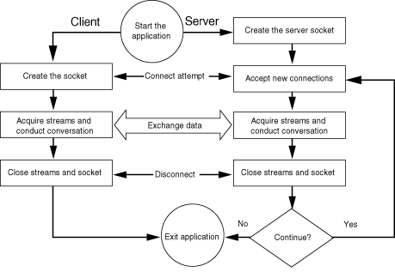
Communication
What the server needs to do.
Create a server socket.
Listen for incoming connection attempts.
Communicate with client.
Interact until it is time to close the connection.
Server or client can close the connection.
Go back to listening.
What the client needs to do
Connect to server.
Send data.
Receive data.
Close the connection.

Slide 6
Types of Sockets
Stream sockets – Uses TCP for Data Transmission
These sockets are most used in Java Programming.
Datagram sockets – Uses UDP for Data Transmission.
Since we have implemented Stream Sockets in the examples further, Lets get the gist of TCP connections in Java
The Socket class is used for handling TCP connections in Java
A socket can be used as a data source for a stream
The SocketServer class is used to establish a connection

Slide 7
Create socket
Java in java.net package, offers two classes: Socket and ServerSocket，represent the client and server respectively. Their super class is SocketImpl .They are two well designed classes ，very convenient to use. Like the following methods：
Socket(InetAddress address, int port);
Socket(InetAddress address, int port, boolean stream);c
Socket(String host, int port);
Socket(SocketImpl impl)
Socket(String host, int port, InetAddress localAddr, int localPort)
ServerSocket(int port);
ServerSocket(int port, int backlog, InetAddress bindAddr)
Notes:
Socket(InetAddress address, int port, boolean stream);

Slide 8
Create socket(continued)
The address , host, and port represents the other side IP address ,host and port number in two-way communication link . Stream represents that whether the socket is stream socket or datagram socket . localPort means the port number of the local host, localAddr and bindAddr are the address of local pc, （ServerSocket’s host address），impl is the super class of socket，so it can be used to create Socket and serverSocket.
Notes:
Datagram :数据报

Slide 9
Create socket(continued)
Socket client = new Socket("127.0.0,1", 80);
ServerSocket server = new ServerSocket(80);
Here should pay attention to choosing a port number。Each port offers a specific service ,so only the port number is correct then the service can be served accordingly . 0~1023 port number are reserved for the system，eg port for http is 80 ,port for telnet service is 23, for ftp service port is 21, so when we choose a port number ,we’d better choose one larger than 1024.
If an errors happens when we create a socket ,it will result in IOException，we must deal with it ,so when create Socket or ServerSocket, we must either catch it or throw it .

Slide 10
TCP Standard Ports
Below 1024, assigned by the IANA
21 | FTP
23 | Telnet
80 | HTTP
110 | POP3
119 | NNTP

Slide 11
Reading from and Writing to a Socket in Java
Let's look at two simple examples that illustrate how a program can establish a connection to a server program using the Socket class and then, how the client can send data to and receive data from the server through the socket. And also if there are more clients ,how the clients communicate with each other .

Slide 12
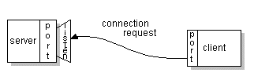

Examples
Server & Client – Single Client and Server Program.
ChatClient & ChatServer- Single Server and Multi-Client Program.
Client1
Server
Client2
Multiple Clients Communicating using a single server.
Client3

Slide 13
Server.java
import java.net.*;
import java.io.*;
public class Server
{
private ServerSocket serverSocket;
public Server(int port) throws Exception
{
serverSocket = new ServerSocket(port);
}
public void run()
{
try
{
System.out.println("Waiting for client on port " + serverSocket.getLocalPort() + "...");
Socket server = serverSocket.accept();
System.out.println("Just connected to "+ server.getRemoteSocketAddress());
DataInputStream in =new DataInputStream(server.getInputStream());
System.out.println(in.readUTF());

Slide 14
DataOutputStream out =new DataOutputStream(server.getOutputStream());
out.writeUTF("Thank you for connecting to "+ server.getLocalSocketAddress() + "\nGoodbye!");
server.close();
}
catch(Exception e)
{
System.out.println("error");
}
}
}

Slide 15
JavaServer.Java – The Main() method to invoke the server
import java.io.IOException;
public class JavaServer
{
public static void main(String [] args)
{
try
{
Server s = new Server(4000);
s.run();
}catch(Exception e)
{
System.out.println("error");
}
}
}

Slide 16
Client.java
import java.net.*;
import java.io.*;
public class Client
{
public static void main(String [] args)
{
String serverName = "127.0.0.1";
int port = 4000;
try
{
System.out.println("Connecting to " + serverName+ " on port " + port);
Socket client = new Socket(serverName, port);
System.out.println("Just connected to"+client.getRemoteSocketAddress());
OutputStream outToServer = client.getOutputStream();
DataOutputStream out =new DataOutputStream(outToServer);
out.writeUTF("Hello from "+ client.getLocalSocketAddress());
InputStream inFromServer = client.getInputStream();

Slide 17
DataInputStream in =new DataInputStream(inFromServer);
System.out.println("Server says " + in.readUTF());
client.close();
}catch(Exception e)
{
System.out.println("error");
}
}
}

Slide 18
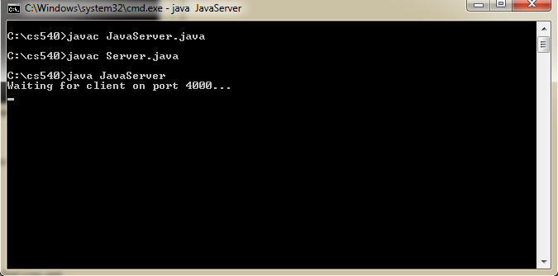
Outputs
Compiling Server

Slide 19
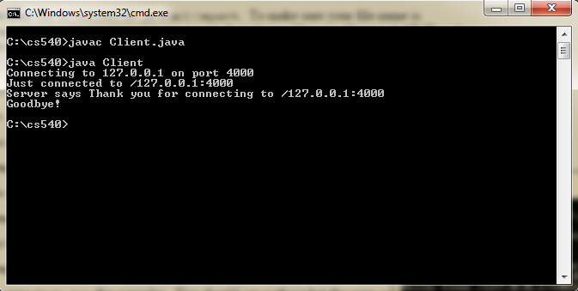
Run Client.java

Slide 20
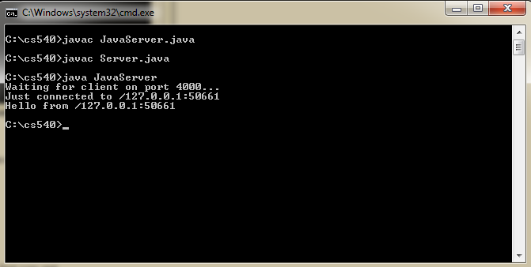
Run Server

Slide 21
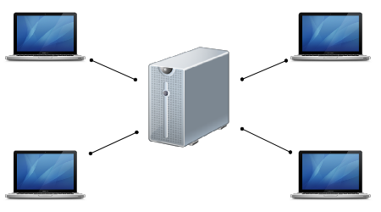
Handling multiple clients
Handling multiple clients in Java is relatively easy and painless compared to C++ for example. This is because Java hides a lot of the complexities of writing your application to make use of multiple threads. The run() method does whatever needs to be done (i.e. reading and writing to the Socket) and then close()s the Socket.

Slide 22
Example2 multiple clients
import java.io.*;
import java.net.*;
import java.util.HashSet;
public class ChatServer {
private static final int PORT = 9002;
private static HashSet<String> names = new HashSet<String>();
private static HashSet<PrintWriter> writers = new HashSet<PrintWriter>();
public static void main(String[] args) throws Exception {
System.out.println("The chat server is running.");
ServerSocket listener = new ServerSocket(PORT);
try {
while (true) {
new Handler(listener.accept()).start();
}
} finally {
listener.close();
}
}

Slide 23
private static class Handler extends Thread {
private String name;
private Socket socket;
private BufferedReader in;
private PrintWriter out;
public Handler(Socket socket) {
this.socket = socket;
}
public void run() {
try {
in = new BufferedReader(new InputStreamReader(socket.getInputStream()));
out = new PrintWriter(socket.getOutputStream(), true);
while (true) {
out.println("SUBMITNAME");
name = in.readLine();
if (name == null) {
return;
}
synchronized (names) { //give a lock on names
if (!names.contains(name)) {
names.add(name);
break;
}
}
}

Slide 24
out.println("NAMEACCEPTED");
writers.add(out);
while (true) {
String input = in.readLine();
if (input == null) {
return;
}
for (PrintWriter writer : writers) {
writer.println("MESSAGE " + name + ": " + input);
}
}

Slide 25
catch (IOException e) {
System.out.println(e);
} finally {
if (name != null) {
names.remove(name);
}
if (out != null) {
writers.remove(out);
}
try {
socket.close();
} catch (IOException e) {
}
}
}
}
}

Slide 26
chatClient:
import java.awt.event.*;
import java.io.*;
import java.net.Socket;
import javax.swing.*;
public class ChatClient {
BufferedReader in;
PrintWriter out;
JFrame frame = new JFrame("Chatter");
JTextField textField = new JTextField(40);
JTextArea messageArea = new JTextArea(8, 40);
public ChatClient() {
textField.setEditable(false);
messageArea.setEditable(false);
frame.getContentPane().add(textField, "North");
frame.getContentPane().add(new JScrollPane(messageArea), "Center");
frame.pack();

Slide 27
textField.addActionListener(new ActionListener() {
public void actionPerformed(ActionEvent e) {
out.println(textField.getText());
textField.setText("");//clear the textfield for the next message
}
});
}
private String getName() {
return JOptionPane.showInputDialog(
frame,
"Choose a nick name:",
"Nick name selection",
JOptionPane.PLAIN_MESSAGE);
}

Slide 28
private void run() throws IOException {
// Make connection and initialize streams
Socket socket = new Socket("localhost", 9098);
in = new BufferedReader(new InputStreamReader(socket.getInputStream()));
out = new PrintWriter(socket.getOutputStream(), true);
// Process all messages from server, according to the protocol.
while (true) {
String line = in.readLine();
if (line.startsWith("SUBMITNAME")) {
out.println(getName());
} else if (line.startsWith("NAMEACCEPTED")) {
textField.setEditable(true);
} else if (line.startsWith("MESSAGE")) {
messageArea.append(line.substring(8) + "\n");
}
}
}

Slide 29
public static void main(String[] args) throws Exception {
ChatClient client = new ChatClient();
client.frame.setDefaultCloseOperation(JFrame.EXIT_ON_CLOSE);
client.frame.setVisible(true);
client.run();
}
}

Slide 30
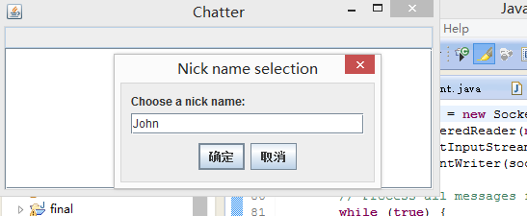
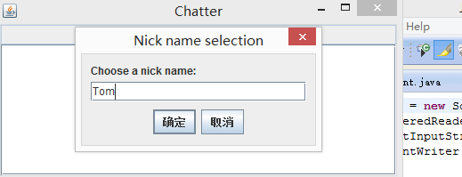
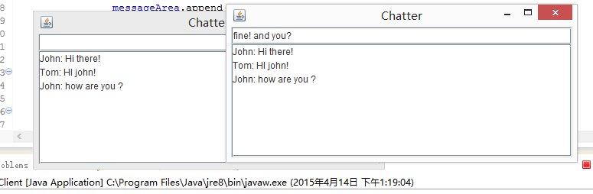
output

Slide 31
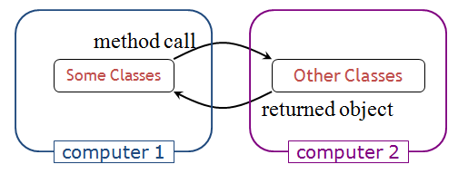
RMI Introduction
RMI
The Java Remote Method Invocation (RMI) system
Allows an object running in one Java virtual machine to invoke methods on an object running in another Java virtual machine.

Slide 32
RMI Introduction (cont’d)
Scenario
Roles
Developer A writes a service that performs some useful function. He regularly updates this service, adding new features and improving existing ones.
Developer B wishes to use the service provided by Developer A. However, it's inconvenient for A to supply B with an update every time.
Goal
Be able to put the two classes into different computers

Slide 33
RMI Introduction (cont’d)
RMI processing
The server calls the registry to associate (or bind) a name with a remote object.
The client looks up the remote object by its name in the server's registry and then invokes a method on it.

Slide 34
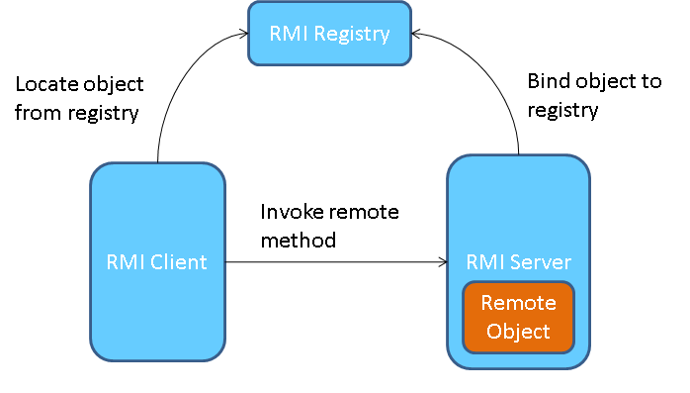
RMI Introduction (cont’d)
RMI processing chart

Slide 35
RMI Components
Server
RMI Registry
Where remote objects are registered

Slide 36
RMI Components (cont’d)
Remote object
An object with methods that can be invoked across Java virtual machines
An object becomes remote by implementing a remote interface
A remote interface extends the interface java.rmi.Remote
Each method of the interface declares java.rmi.RemoteException in its throws clause, in addition to any application-specific exceptions
Remote object class
Defines a constructor and implements the methods
Extends java.rmi.server.UnicastRemoteObject
Used for exporting a remote object with JRMP and obtaining a stub that communicates to the remote object.

Slide 37
RMI Components (cont’d)
Stub
Acts as the local representative, or proxy, for the remote object and basically is, to the client, the remote reference.
A stub for a remote object implements the same set of remote interfaces that the remote object implements.

Slide 38
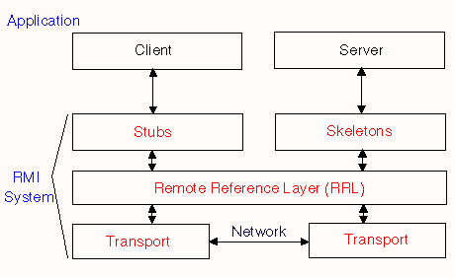
RMI Components (cont’d)
Client
Invokes a method on the local stub, which is responsible for carrying out the method invocation on the remote object.

Slide 39
Steps to Make a RMI Application
Defining the remote interface
Implementing the remote object
Implementing the server
Implementing the client

Slide 40
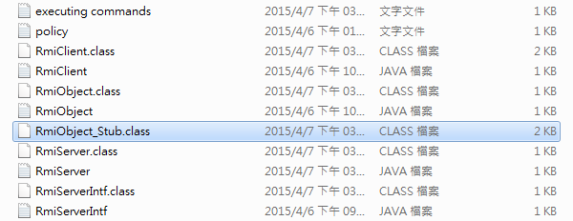
RMI Compiling
rmic
Create stub class (client-side) and skeleton class (server-side)
Skeletons are no longer required for remote method calls in the Java 2 platform v1.2 and greater

Slide 41
RMI Compiling (cont’d)
With versions prior to Java Platform, Standard Edition 5.0, an additional step was required to build stub classes, by using the rmic compiler. However, this step is no longer necessary

Slide 42
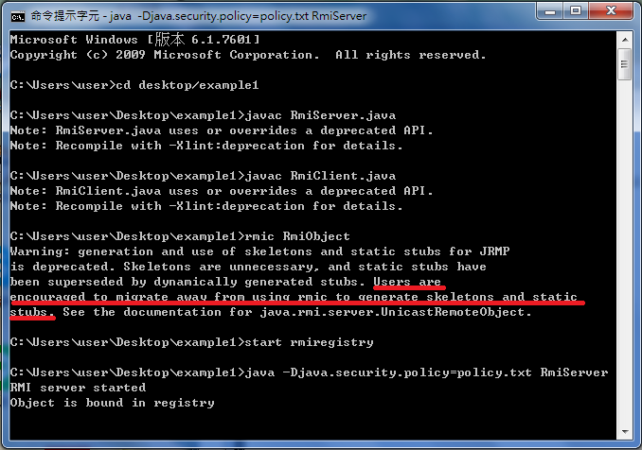
RMI Compiling (cont’d)
rmic

Slide 43
Security Manager
Protects access to system resources from un-trusted downloaded code running within the Java virtual machine
Determines whether downloaded code has access to the local file system or can perform any other privileged operations.
Creates and installs a security manager
System.setSecurityManager(new SecurityManager());

Slide 44
Important RMI Class Methods
Naming.bind(String name, Remote obj);
Binds the specified name to a remote object
String
“rmi://” + host + “:” + port + ”/” + objectName
Default port number is 1099
Naming.lookup(String name);
Returns a reference, a stub, for the remote object associated with the specified name

Slide 45
RMI Example 1 – Remote Object Interface
import java.rmi.Remote;
import java.rmi.RemoteException;
public interface RmiObjectIntf extends Remote {
public void setName(String name) throws RemoteException;
public String getName() throws RemoteException;
}

Slide 46
RMI Example 1 – Remote Object
import java.rmi.RemoteException;
import java.rmi.server.UnicastRemoteObject;
public class RmiObject extends UnicastRemoteObject implements RmiObjectIntf {
private String name;
//constructor
public RmiObject() throws RemoteException {
super();
}
public void setName(String name) throws RemoteException {
this.name=name;
}
public String getName() throws RemoteException {
return this.name;
}
}

Slide 47
RMI Example 1 – Server
import java.rmi.Naming;
import java.rmi.RemoteException;
import java.rmi.server.UnicastRemoteObject;
import java.rmi.registry.*;
import java.rmi.RMISecurityManager;
public class RmiServer{
public static void main(String args[]) throws Exception {
System.out.println("RMI server started");
//assign a security manager
if (System.getSecurityManager() == null)
System.setSecurityManager(new RMISecurityManager());

Slide 48
RMI Example 1 – Server (cont’d)
//instantiate RmiObject
RmiObject obj = new RmiObject();
//bind this object instance with the RMI Registry to the name "RmiObject"
//rmi://" + host + ":" + port + "/" + objectName
//default port is 1099
Naming.rebind("rmi://localhost/RmiObject", obj);
System.out.println("Object is bound in registry");
}
}

Slide 49
RMI Example 1 – Client
import java.rmi.RMISecurityManager;
import java.rmi.Naming;
public class RmiClient {
public static void main(String args[]) throws Exception {
//assign security manager
if (System.getSecurityManager() == null)
System.setSecurityManager(new RMISecurityManager());
//call registry
RmiObjectIntf obj = (RmiObjectIntf) Naming.lookup("rmi://localhost/RmiObject");
obj.setName(args[0]);
System.out.println("Name: " + obj.getName());
}
}

Slide 50
RMI Example 1 – policy.txt
grant {
permission java.security.AllPermission;
};
The policy file controls which permissions it has
This example gives all permissions
The AllPermission is a permission that implies all other permissions.

Slide 51
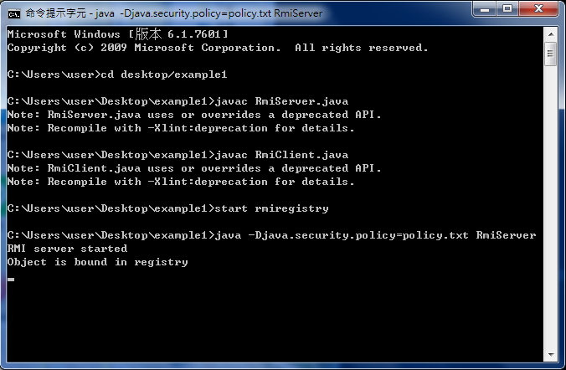
RMI Example 1 – Executing

Slide 52
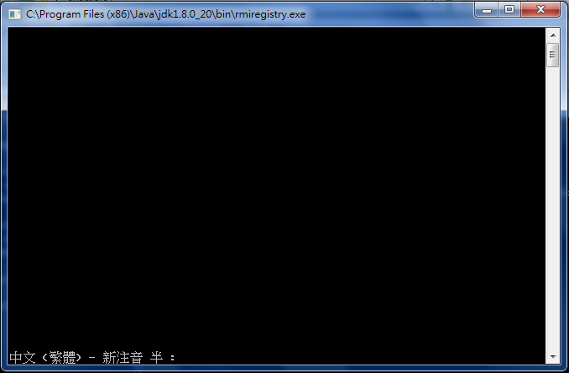
RMI Example 1 – Executing (cont’d)
Unix user should use “rmiregistry &”

Slide 53
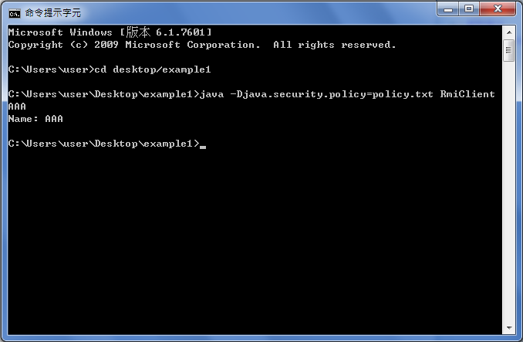
RMI Example 1 – Result

Slide 54
RMI Example 2 – Remote Object (Server) Interface
import java.rmi.Remote;
import java.rmi.RemoteException;
public interface RmiServerIntf extends Remote {
public float plus(float num1, float num2) throws RemoteException;
}

Slide 55
RMI Example 2 – Server
import java.rmi.Naming;
import java.rmi.RemoteException;
import java.rmi.server.UnicastRemoteObject;
import java.rmi.registry.*;
import java.rmi.RMISecurityManager;
import java.util.*;
public class RmiServer extends UnicastRemoteObject implements RmiServerIntf {
//constructor
public RmiServer() throws RemoteException {
super();
}
public float plus(float num1, float num2) throws RemoteException {
return num1 + num2;
}

Slide 56
RMI Example 2 – Server (cont’d)
public static void main(String args[]) throws Exception {
System.out.println("RMI server started");
//create registry => no need to run "start rmiregistry" to start the registry
try { //exception handler for registry creation
LocateRegistry.createRegistry(1099); //default port is 1099
System.out.println("java RMI registry is created.");
} catch (RemoteException e) {
System.out.println("java RMI registry already exists.");
}

Slide 57
RMI Example 2 – Server (cont’d)
//assign a security manager
if (System.getSecurityManager() == null)
System.setSecurityManager(new RMISecurityManager());
//instantiate RmiServer
RmiServer obj = new RmiServer();
//bind this object instance with the RMI Registry to the name "RmiServer"
//rmi://" + host + ":" + port + "/" + objectName
//default port is 1099
Naming.rebind("rmi://localhost/RmiServer", obj);
System.out.println("Object is bound in registry");
}
}

Slide 58
RMI Example 2 – Client
import java.rmi.RMISecurityManager;
import java.rmi.Naming;
public class RmiClient {
public static void main(String args[]) throws Exception {
//assign security manager
if (System.getSecurityManager() == null)
System.setSecurityManager(new RMISecurityManager());
//call registry
RmiServerIntf obj = (RmiServerIntf) Naming.lookup("rmi://localhost/RmiServer");
System.out.println(obj.plus(Float.parseFloat(args[0]), Float.parseFloat(args[1])));
}
}

Slide 59
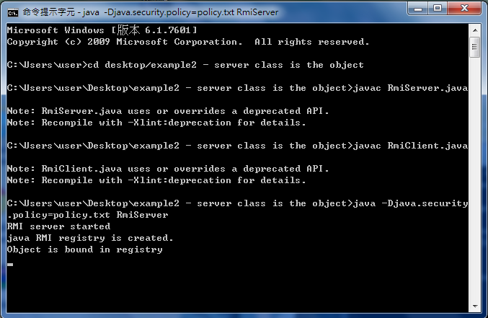
RMI Example 2 – Executing

Slide 60
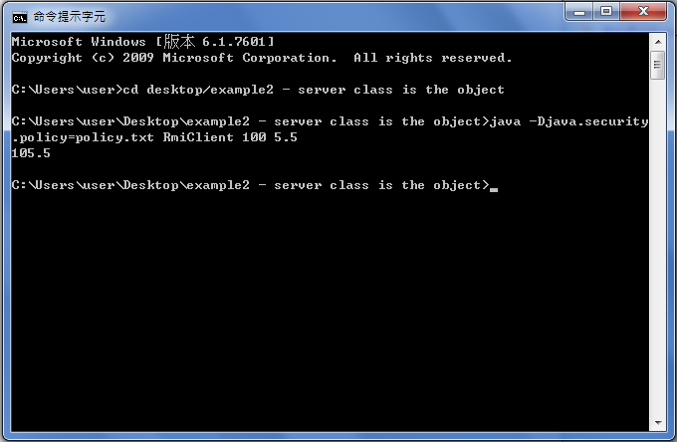
RMI Example 2 – Result

Slide 61
RMI Example 3 – Remote Object 1 Interface
import java.rmi.Remote;
import java.rmi.RemoteException;
public interface RmiObjectIntf1 extends Remote {
public void setName(String name) throws RemoteException;
public String getName() throws RemoteException;
}

Slide 62
RMI Example 3 – Remote Object 2 Interface
import java.rmi.Remote;
import java.rmi.RemoteException;
public interface RmiObjectIntf2 extends Remote {
public int plus(int num1, int num2) throws RemoteException;
}

Slide 63
RMI Example 3 – Remote Object 1
import java.rmi.RemoteException;
import java.rmi.server.UnicastRemoteObject;
public class RmiObject1 extends UnicastRemoteObject implements RmiObjectIntf1 {
private String name;
//constructor
public RmiObject1() throws RemoteException {
super();
}
public void setName(String name) throws RemoteException {
this.name=name;
}
public String getName() throws RemoteException {
return this.name;
}
}

Slide 64
RMI Example 3 – Remote Object 2
import java.rmi.RemoteException;
import java.rmi.server.UnicastRemoteObject;
public class RmiObject2 extends UnicastRemoteObject implements RmiObjectIntf2 {
//constructor
public RmiObject2() throws RemoteException {
super();
}
public int plus(int num1, int num2) throws RemoteException {
return num1 + num2;
}
}

Slide 65
RMI Example 3 – Server
import java.rmi.Naming;
import java.rmi.RemoteException;
import java.rmi.server.UnicastRemoteObject;
import java.rmi.registry.*;
import java.rmi.RMISecurityManager;
public class RmiServer{
public static void main(String args[]) throws Exception {
System.out.println("RMI server started");
//create registry => no need to run "start rmiregistry" to start the registry
try { //exception handler for registry creation
LocateRegistry.createRegistry(1099); //default port is 1099
System.out.println("java RMI registry is created.");
} catch (RemoteException e) {
System.out.println("java RMI registry already exists.");
}

Slide 66
RMI Example 3 – Server (cont’d)
//assign a security manager
if (System.getSecurityManager() == null)
System.setSecurityManager(new RMISecurityManager());
//instantiate RmiObject
RmiObject1 obj1 = new RmiObject1();
RmiObject2 obj2 = new RmiObject2();
//bind this object instance with the RMI Registry to the name "RmiObject"
//rmi://" + host + ":" + port + "/" + objectName
//default port is 1099
Naming.rebind("rmi://localhost/RmiObject1", obj1);
Naming.rebind("rmi://localhost/RmiObject2", obj2);
System.out.println("Objects are bound in registry");
}
}

Slide 67
RMI Example 3 – Client
import java.rmi.RMISecurityManager;
import java.rmi.Naming;
public class RmiClient {
public static void main(String args[]) throws Exception {
//assign security manager
if (System.getSecurityManager() == null)
System.setSecurityManager(new RMISecurityManager());
//call registry
RmiObjectIntf1 obj1 = (RmiObjectIntf1) Naming.lookup("rmi://localhost/RmiObject1");
obj1.setName("testName");
System.out.println("Name: " + obj1.getName());
RmiObjectIntf2 obj2 = (RmiObjectIntf2) Naming.lookup("rmi://localhost/RmiObject2");
System.out.println("Plus: " + obj2.plus(1,2));
}
}

Slide 68
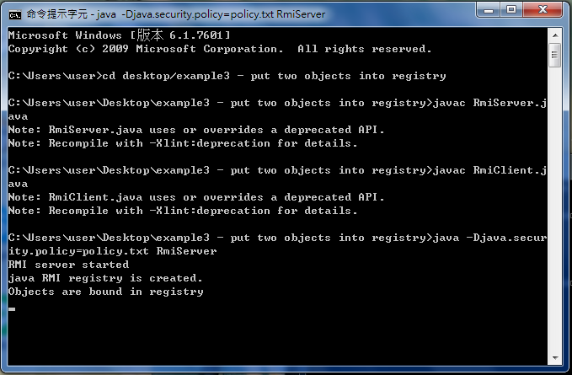
RMI Example 3 – Executing

Slide 69
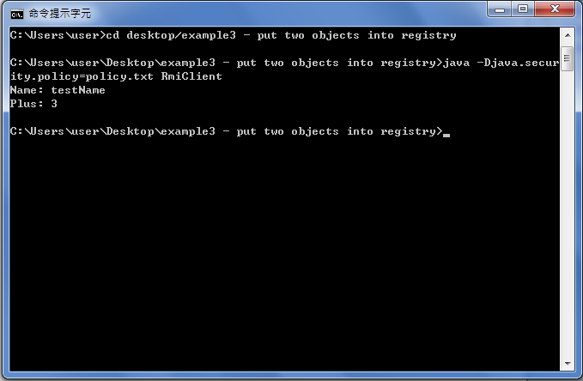
RMI Example 3 – Result

Slide 70
Running JAVA RMI Under Eclipse
Start rmiregistry under the folder where your .classes files are
C:\Users\user\workspace\Example\classes
Otherwise, rmiregistry application doesn't know where to load classes from => ClassNotFoundException
Start it by commandlines
start rmiregistry port => ex: start rmiregistry 1099

Slide 71
Running JAVA RMI Under Eclipse (cont’d)
java –Djava.security.policy=policy.txt RmiServer in Linux
Using run configurations to setup VM arguments
-Djava.security.policy
=file:${workspace_loc}/${project_name}/security.polic
=file:C:\Users\user\workspace\Example\src\security.policy

Slide 72
Running JAVA RMI Under Eclipse (cont’d)
java –Djava.security.policy=policy.txt RmiClient Wendy in Linux
Using run configurations to setup Program arguments
Wendy

Slide 73
RMI Example 4 – Remote Object Interface
import java.rmi.Remote;
import java.rmi.RemoteException;
public interface ObjectIntf extends Remote {
public void setPrinted(boolean printed) throws RemoteException;
public boolean isPrinted() throws RemoteException;
public void sendMessage(String message) throws RemoteException;
public String getMessage() throws RemoteException;
}

Slide 74
RMI Example 4 – Remote Object
import java.rmi.RemoteException;
import java.rmi.server.UnicastRemoteObject;
public class Object extends UnicastRemoteObject implements ObjectIntf {
private boolean isPrinted = false;
private String message;
public Object() throws RemoteException {
super();
}

Slide 75
RMI Example 4 – Remote Object (cont’d)
@Override
public void setPrinted(boolean printed) throws RemoteException {
this.isPrinted = printed;
}
@Override
public boolean isPrinted() throws RemoteException {
return this.isPrinted;
}

Slide 76
RMI Example 4 – Remote Object (cont’d)
@Override
public void sendMessage(String message) throws RemoteException {
this.message = message;
}
@Override
public String getMessage() throws RemoteException {
return this.message;
}
}

Slide 77
RMI Example 4 – Server
import java.rmi.Naming;
import java.rmi.RemoteException;
import java.rmi.server.UnicastRemoteObject;
import java.rmi.registry.*;
import java.rmi.RMISecurityManager;
public class Server{
public static void main(String args[]) throws Exception {
System.out.println("RMI server started");

Slide 78
RMI Example 4 – Server (cont’d)
if (System.getSecurityManager() == null)
System.setSecurityManager(new RMISecurityManager());
Object messageObj = new Object();
Naming.rebind("rmi://localhost:2000/messageObject", messageObj);
System.out.println("Object is bound in registry");
}
}

Slide 79
RMI Example 4 – Client
import java.rmi.RMISecurityManager;
import java.rmi.Naming;
import java.rmi.RemoteException;
import java.awt.*;
import java.awt.event.ActionEvent;
import java.awt.event.ActionListener;
import javax.swing.*;
public class Client extends JFrame implements ActionListener{
static JFrame frame = new JFrame();
JTextField textField;
static JTextArea messageArea;
static String username;
static ObjectIntf messageObj;

Slide 80
RMI Example 4 – Client (cont’d)
public Client()
{
setTitle(username);
setDefaultCloseOperation(JFrame.EXIT_ON_CLOSE);
setSize(400, 200);
setLayout(new BorderLayout( ));
JPanel textPanel = new JPanel( );
textPanel.setLayout(new GridLayout( ));
textField = new JTextField(40);
textField.setBackground(Color.WHITE);
textPanel.add(textField);
add(textPanel, BorderLayout.NORTH);

Slide 81
RMI Example 4 – Client (cont’d)
JPanel messagePanel = new JPanel( );
messagePanel.setLayout(new GridLayout( ));
messageArea = new JTextArea(8, 40);
messageArea.setBackground(Color.WHITE);
messagePanel.add(messageArea);
add(messagePanel, BorderLayout.CENTER);
textField.addActionListener(this);
}

Slide 82
RMI Example 4 – Client (cont’d)
@Override
public void actionPerformed(ActionEvent e) {
// TODO Auto-generated method stub
try {
messageObj.sendMessage(username + ": " + textField.getText() + "\n");
textField.setText("");
messageObj.setPrinted(false);
} catch (RemoteException e1) {
// TODO Auto-generated catch block
e1.printStackTrace();
}
}

Slide 83
RMI Example 4 – Client (cont’d)
public static void main(String args[]) throws Exception {
username = JOptionPane.showInputDialog(
frame,
"Please enter a name.",
"Set Chatroom Nickname",
JOptionPane.WARNING_MESSAGE
);
Client client = new Client( );
client.setVisible(true);

Slide 84
RMI Example 4 – Client (cont’d)
if (System.getSecurityManager() == null)
System.setSecurityManager(new RMISecurityManager());
messageObj = (ObjectIntf) Naming.lookup("rmi://localhost:2000/messageObject");
while(true)
{
if(!messageObj.isPrinted())
{
messageArea.append(messageObj.getMessage());
messageObj.setPrinted(true);
}
}
}

Slide 85
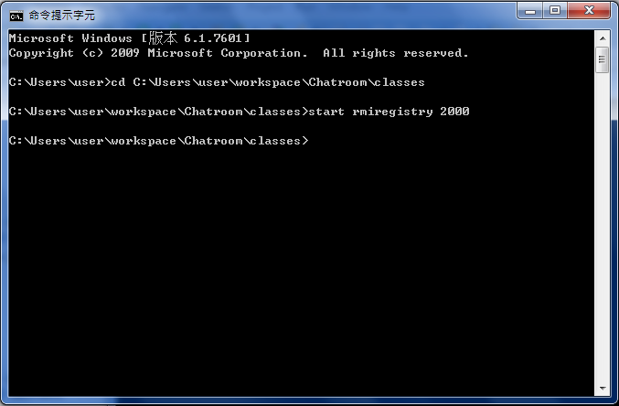
RMI Example 4 – Executing

Slide 86
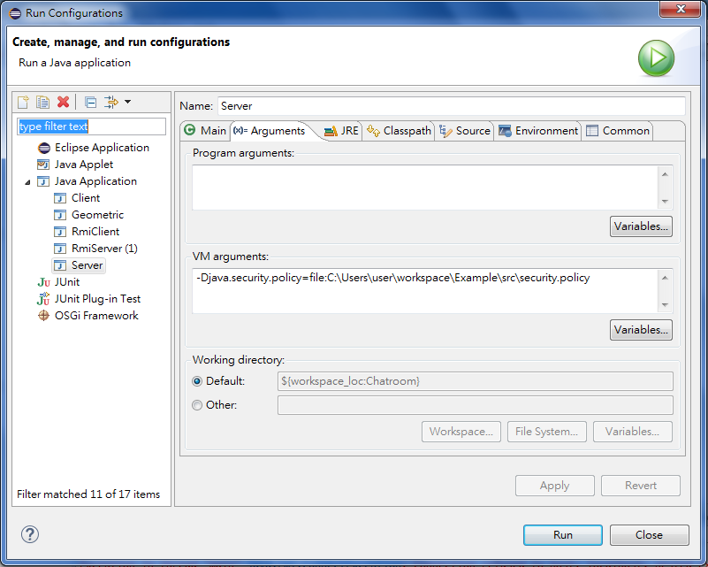
RMI Example 4 – Executing (cont’d)

Slide 87
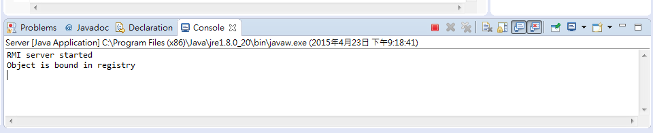
RMI Example 4 – Executing (cont’d)

Slide 88
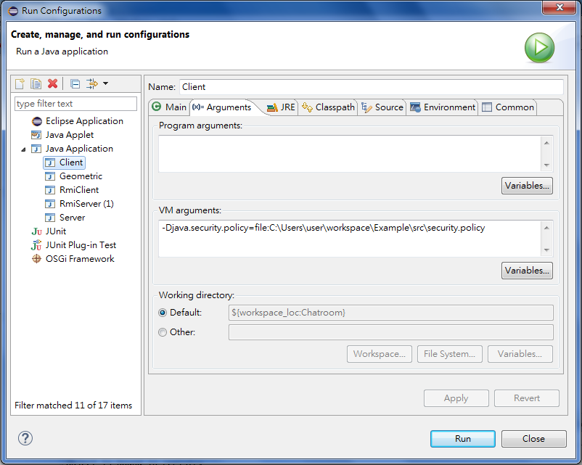
RMI Example 4 – Executing (cont’d)

Slide 89
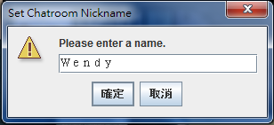
RMI Example 4 – Executing (cont’d)

Slide 90
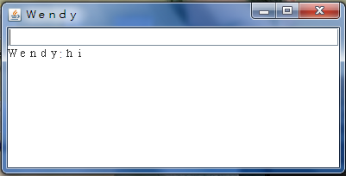
RMI Example 4 – Result

Slide 91
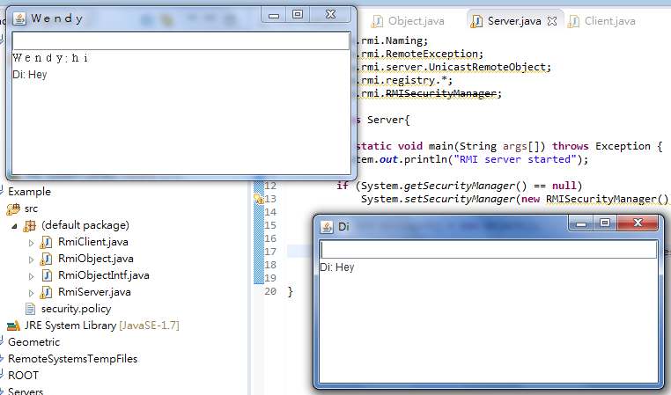
RMI Example 4 – Result (cont’d)

Slide 92
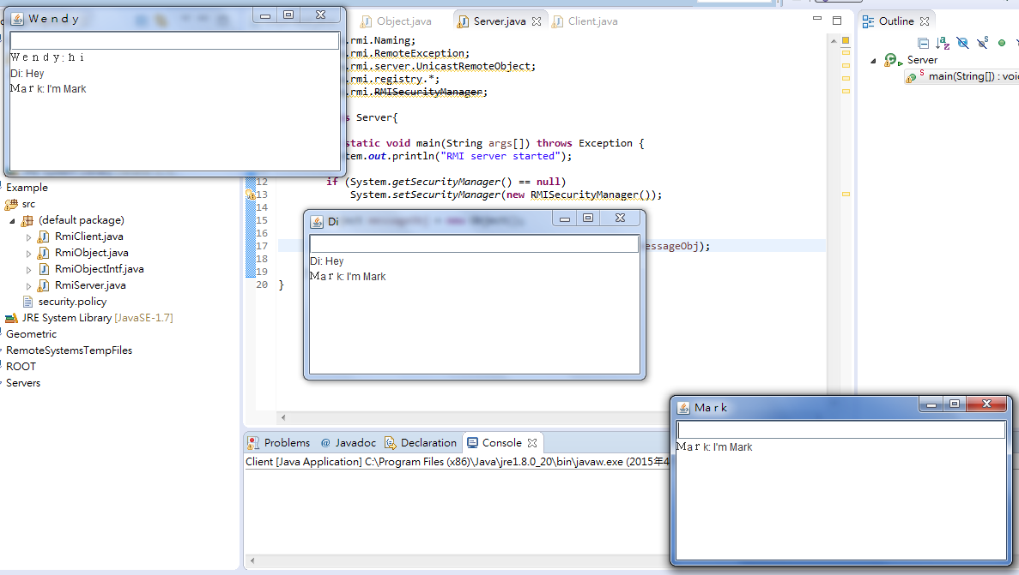
RMI Example 4 – Result (cont’d)

Slide 93
RMI vs. Socket
RMI is built on top of sockets. It translates method calls and return values and sends those through sockets.
Sockets are used for transferring data
RMI is a Java-specific protocol for invoking methods
Sockets are for low-level network communication
RMI is for high-level Java-to-Java distributed computing

Slide 94
RMI vs. Socket (cont’d)
Socket - you have to handle exactly which sockets are being used, you specify TCP or UDP, you handle all the formatting of messages travelling between client and server.
RMI - hides much of the network specific code, you don't have to worry about specific ports used, RMI handles the formatting of messages between client and server.

Slide 95
.NET Remoting (C#)
Enables building widely distributed applications by providing a framework that allows objects to interact with each other across application domains, and across network.
Can build client applications that use objects in other processes on the same computer or on any other computer that is reachable over its network.
Can also use .NET remoting to communicate with other application domains in the same process.

Slide 96
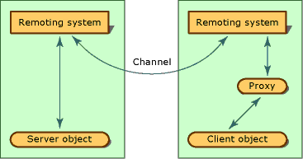
.NET Remoting Architecture
Notes:
Suppose you have an application running on one computer, and you want to use the functionality exposed by a type that is stored on another computer. The following illustration shows the general remoting process. If both sides of the relationship are configured properly, a client merely creates a new instance of the server class.
The remoting system creates a proxy object that represents the class and returns to the client object a reference to the proxy. When a client calls a method, the remoting infrastructure handles the call, checks the type information, and sends the call over the channel to the server process. A listening channel picks up the request and forwards it to the server remoting system, which locates (or creates, if necessary) and calls the requested object. The process is then reversed, as the server remoting system bundles the response into a message that the server channel sends to the client channel. Finally, the client remoting system returns the result of the call to the client object through the proxy.

Slide 97
Basic Components
A remotable object.
To make an object remotable, implement abstract class
MarshalByRefObject – Enables access to objects across application domain boundaries in applications that support remoting
A server/host application domain to listen for requests for that object.
A client application domain that makes requests for that object.
MarshalByRefObject

Slide 98
Remoting Object Modes
Single Call – Single Call objects service one and only one request coming in.
Singleton - Singleton objects are those objects that service multiple clients and hence share data by storing state information between client invocations.
Client-Activated Objects (CAO) - Client-activated objects (CAO) are server-side objects that are activated upon request from the client.
Notes:
Single Call Single Call objects service one and only one request coming in. Single Call objects are useful in scenarios where the objects are required to do a finite amount of work. Single Call objects are usually not required to store state information, and they cannot hold state information between method calls. However, Single Call objects can be configured in a load-balanced fashion.
Singleton Objects Singleton objects are those objects that service multiple clients and hence share data by storing state information between client invocations. They are useful in cases in which data needs to be shared explicitly between clients and also in which the overhead of creating and maintaining objects is substantial.
Client-Activated Objects (CAO) Client-activated objects (CAO) are server-side objects that are activated upon request from the client. When the client submits a request for a server object using "new" operator, an activation request message is sent to the remote application. The server then creates an instance of the requested class and returns an ObjRef back to the client application that invoked it. A proxy is then created on the client side using the ObjRef. The client's method calls will be executed on the proxy. Client-activated objects can store state information between method calls for its specific client and not across different client objects. Each invocation of "new" returns a proxy to an independent instance of the server type.

Slide 99
Register remotable object on service end
RemotingConfiguration.RegisterWellKnownServiceType([Type of remotable object], [Object URI], WellKnownObjectMode.[Object mode]);
Behavior (type) of remotable object must be known by both server and client, but client does not need to know the implementation of the remotable object.
Object URI – Provides an object representation of a unique resource identifier. Will be used by client to lookup for the remotable object.
Object mode – depending on needs.

Slide 100
Setup
Visual Studio 2013
.NET 4.0
Reference “System.Runtme.Remoting”
Can use “Http” or “Tcp” communication protocol

Slide 101
Example 1 – Multi-client information lookup
Application scenario:
- Client side application only needs to know remote object behavior (type), but not implementation.
- Server side manages data and responds to server requests.
- Client side and server side development can conduct in parallel as long as the remote object type is kept the same.

Slide 102
Example 1 – Architecture
Client
Server
RemoteType
RemoteType
GameChecker (remotable)
MovieChecker (remotable)
game (reference)
movie (reference)

Slide 103
RemoteType.cs – interface
public interface RemoteType
{
string GetStatus(string gameName);
}

Slide 104
Server.cs
using System;
using System.Runtime.Remoting;
using System.Runtime.Remoting.Channels;
using System.Runtime.Remoting.Channels.Tcp;
using RemoteType;
class Server
{
static void Main(string[] args)
{
ChannelServices.RegisterChannel(new TcpChannel(9999), false);
RemotingConfiguration.RegisterWellKnownServiceType(Type.GetType("GameChecker"), "GameChecker", WellKnownObjectMode.Singleton);
RemotingConfiguration.RegisterWellKnownServiceType(Type.GetType("MovieChecker"), "MovieChecker", WellKnownObjectMode.Singleton);
Console.WriteLine("Game/movie checker server started...");
Console.WriteLine("Press ENTER to terminate.");
Console.ReadLine();
}
}

Slide 105
public class GameChecker : MarshalByRefObject, RemoteType
{
public string GetStatus(string gameName)
{
Console.WriteLine("[Game] Someone checked the status of {0}", gameName);
Boolean available = false;
switch (gameName.ToLower())
{
case "gta v":
available = true;
break;
case "assasin's creed":
available = true;
break;
case "battlefield":
available = true;
break;
}
if (available)
return "Game: " + gameName + " is available!";
return "Game: " + gameName + " is NOT available, please check back later.";
}
}

Slide 106
public class MovieChecker : MarshalByRefObject, RemoteType
{
public string GetStatus(string movieName)
{
Console.WriteLine("[Movie] Someone checked the status of {0}", movieName);
Boolean available = false;
switch (movieName.ToLower())
{
case "ff7":
available = true;
break;
case "matrix":
available = true;
break;
case "interstellar":
available = true;
break;
}
if (available)
return "Movie: " + movieName + " is available!";
return "Movie: " + movieName + " is NOT available, please check back later.";
}
}

Slide 107
Form1.cs – core of Client
using System;
using System.Windows.Forms;
using System.Runtime.Remoting;
using System.Runtime.Remoting.Channels;
using System.Runtime.Remoting.Channels.Tcp;
namespace ClientUI
{
public partial class Form1 : Form
{
RemoteType game;
RemoteType movie;
public Form1()
{
InitializeComponent();
ChannelServices.RegisterChannel(new TcpChannel(), false);
game = (RemoteType)Activator.GetObject(typeof(RemoteType), "tcp://localhost:9999/GameChecker");
movie = (RemoteType)Activator.GetObject(typeof(RemoteType), "tcp://localhost:9999/MovieChecker");
}

Slide 108
private void button1_Click(object sender, EventArgs e)
{
try
{
if (gameTextBox.Text != null && gameTextBox.Text != "")
gameResultLabel.Text = game.GetStatus(gameTextBox.Text);
if (movieTextBox.Text != null && movieTextBox.Text != "")
movieResultLabel.Text = movie.GetStatus(movieTextBox.Text);
}
catch (Exception ex)
{
gameResultLabel.Text = "The server is not responding, please check back later.";
movieResultLabel.Text = "";
}
}
}
}

Slide 109
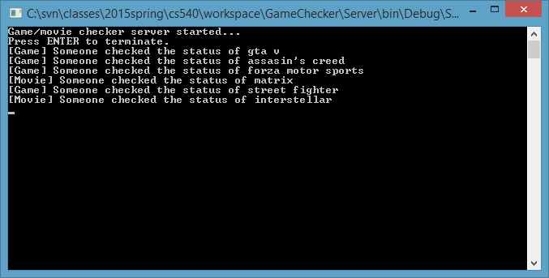
Example 1 Output
Server

Slide 110
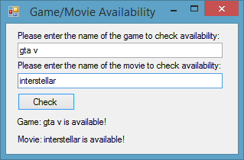
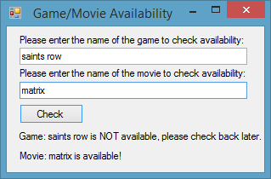
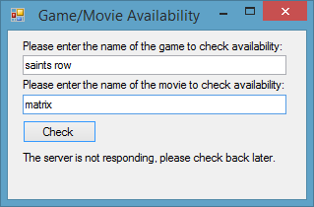
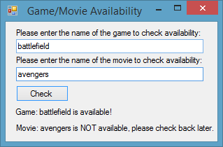
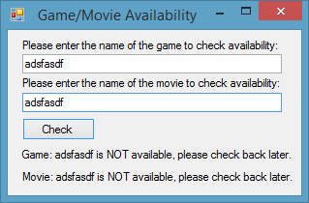
Example 1 Output Cont.
Clients

Slide 111
DEMO

Slide 112
Example 2 – Chatroom
Application Senario:
- “Singleton” mode remoting object allows multiple clients to share the same object, which can be used to shared information between clients.

Slide 113
Example 2 – Architecture
Client
Server
RemoteType (same)
RemoteType (remotable):
Data:
Messages
Latest message key
Data:
Local message key
Send
Receive

Slide 114
RemoteType.cs
using System;
using System.Runtime.Remoting;
using System.Runtime.Remoting.Channels;
using System.Runtime.Remoting.Channels.Tcp;
using System.Collections;
namespace Server
{
class RemoteType : MarshalByRefObject
{
Hashtable messages = new Hashtable();
int currentKey = 0;
public int getCurrentKey()
{
return currentKey;
}

Slide 115
public void sendMsg(string msg)
{
messages.Add(++currentKey, msg);
Console.WriteLine("Message key = {0}", currentKey);
}
public string receiveMsg(int clientKey)
{
if (currentKey > clientKey)
return messages[clientKey + 1].ToString();
else
return "";
}
}
}

Slide 116
Server.cs
using System;
using System.Runtime.Remoting;
using System.Runtime.Remoting.Channels;
using System.Runtime.Remoting.Channels.Tcp;
namespace Server
{
class Server
{
static void Main(string[] args)
{
ChannelServices.RegisterChannel(new TcpChannel(9999), false);
RemotingConfiguration.RegisterWellKnownServiceType(typeof(RemoteType), "ChatRoom", WellKnownObjectMode.Singleton);
Console.WriteLine("Chat server started...");
Console.WriteLine("Press ENTER to terminate.");
Console.ReadLine();
}
}
}

Slide 117
Form1.cs – core of client
using System;
using System.Windows.Forms;
using System.Runtime.Remoting;
using System.Runtime.Remoting.Channels;
using System.Runtime.Remoting.Channels.Tcp;
using Server;
namespace Client
{
public partial class Form1 : Form
{
RemoteType remote;
int localKey = 0;
string username;
public Form1(string username)
{
InitializeComponent(username);
remote = (RemoteType)Activator.GetObject(typeof(RemoteType), "tcp://localhost:9999/ChatRoom");
this.username = username;
localKey = remote.getCurrentKey();
infoLbl.Text = "localKey is updated to " + localKey;
}

Slide 118
private void sendBtn_Click(object sender, EventArgs e)
{
if (msgBox.Text.Trim().Length > 0)
{
remote.sendMsg(username + ": " + msgBox.Text);
msgBox.Text = "";
}
}

Slide 119
private void timer1_Tick(object sender, EventArgs e)
{
string newMsg = remote.receiveMsg(localKey);
if (newMsg.Trim().Length > 0)
{
if (displayBox.Text == "")
{
displayBox.Text = newMsg;
}
else
{
displayBox.Text = displayBox.Text + "\r\n" + newMsg;
}
localKey++;
infoLbl.Text = "localKey = " + localKey;
}
}
}
}

Slide 120
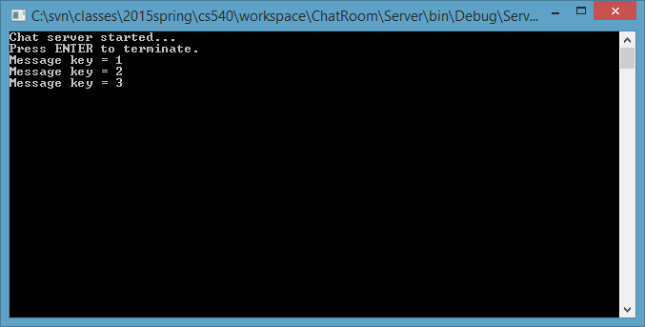
Example 2 Output
Server

Slide 121
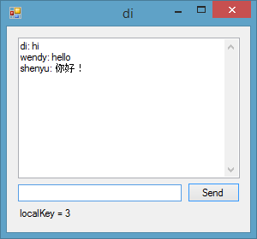


Example 2 Output Cont.
Clients

Slide 122
DEMO

